Slide 1
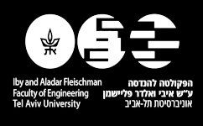

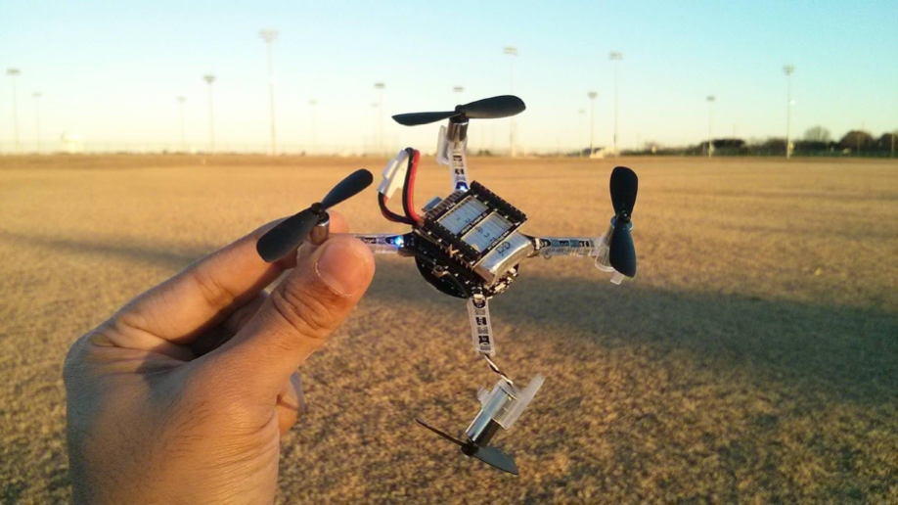
CRAZYFLIE 2.0 DRONE STABILISATION
FINAL PROJECT
BY : LAURENE BOUSKILA, SHIR BARLAS
SUPERVISOR : YONI MANDEL

Slide 2
UAV’s in our world
Nowadays, Unmanned aerial vehicles are more and more present in the challenges our technological world faces.
This can be observed by the variety of fields drones are used in.
In agriculture for example, they can control the plantations growth and detect needs for fertilisers and eventually spread them.
In photography, they allow an overall view from unreachable places.
And for security concerns; quad rotors play an important role by watching our borders.

Slide 3

Xtend
The startup we had the opportunity to complete our project with is called Xtend.
This brand new company sits at TAU ventures and works on human extension technology using drones and VR (virtual reality).
Xtend is looking to enable an innovative way to experience life extending reality beyond physical limits using advanced new medias and flight technologies.

Slide 4
BitCraze
BitCraze is a company that develops and manufactures the Crazyflie: a small, versatile quadcopter for research and education.
They also provide an ecosystem of expansion decks, clients and development tools to enable rapid development, flexibility and ease of use.

Slide 5
Our project : Stabilisation of the Crazyflie 2.0
Created by the bitcraze company, the Crazyflie 2.0 is the drone we worked with throughout our project.
The open source code available on GitHub was also one of our main resources for this research.
Our final goal was to improve the stabilisation of this quadropter.

Slide 6
An engineering challenge
?
?
?
This project led us to the engineering fields of Control theory, Practical feedback and systems as well as through the Robotic world of course.
We also had to use programming languages (python, C), in order to understand and modify the code governing the flight of the drone.
We hope this research will help in some way the development of the crazyflie 2.0 for further work.

Slide 7
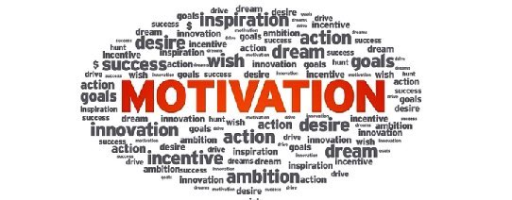
Motivations
Our aim was the following:
When throwing the Crazyflie into the air, giving it a random impulse and direction, that the device stabilises and set to hover mode.
For now, the device was only able to take off from the floor, follow a specific trajectory and then land back.
To face this demand we had to take into account the following measurements: the roll, pitch and yaw angles depicted hereafter.
These datas are read from the various sensors available on the Crazyflie 2.0 .

Slide 8
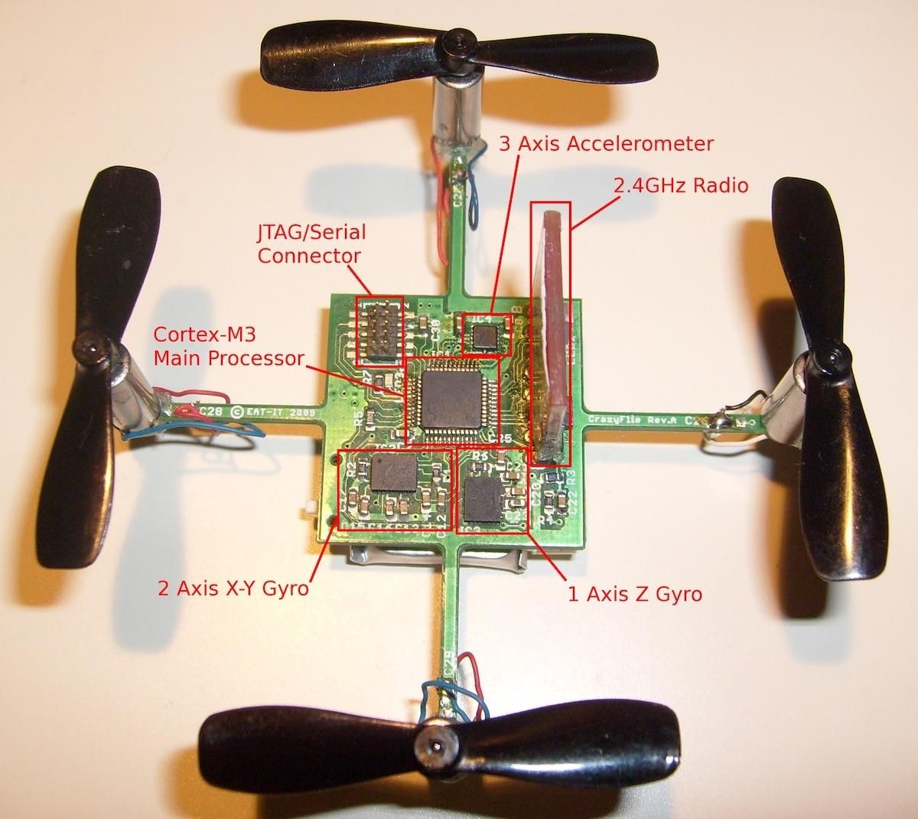
Sensors
To this end, we needed to chose on which data to work on. That is to say, the crazyflie gets various datas from different sensors.
We chose to work on the drone’s sensitivity to detect a change in
-air pressure: Barometer
-location and displacement above the ground: Flowdeck
-orientation and the non-gravitational acceleration :IMU sensors chip composed out of gyroscope and accelerometer

Slide 9
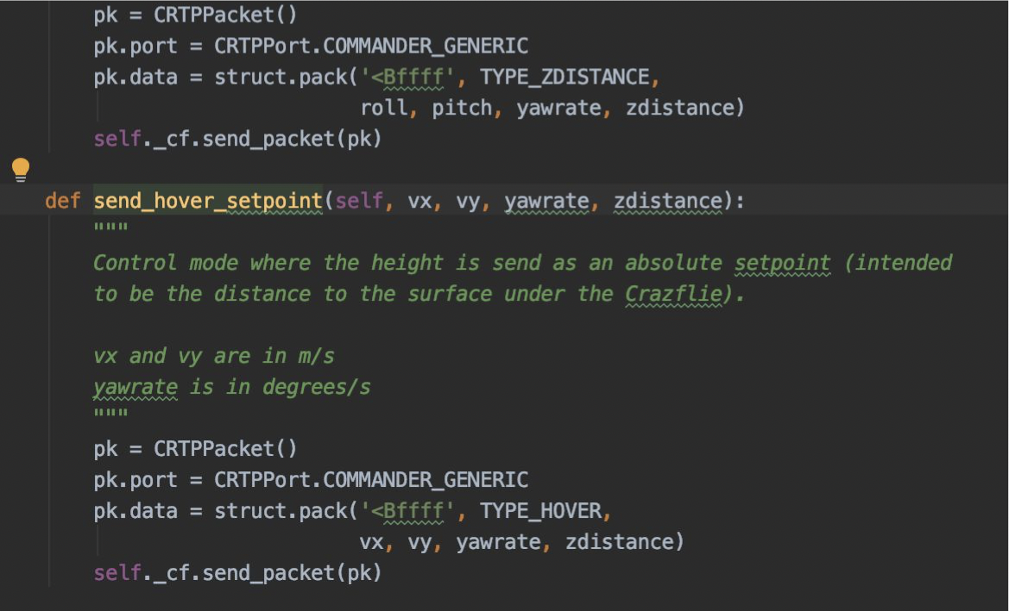
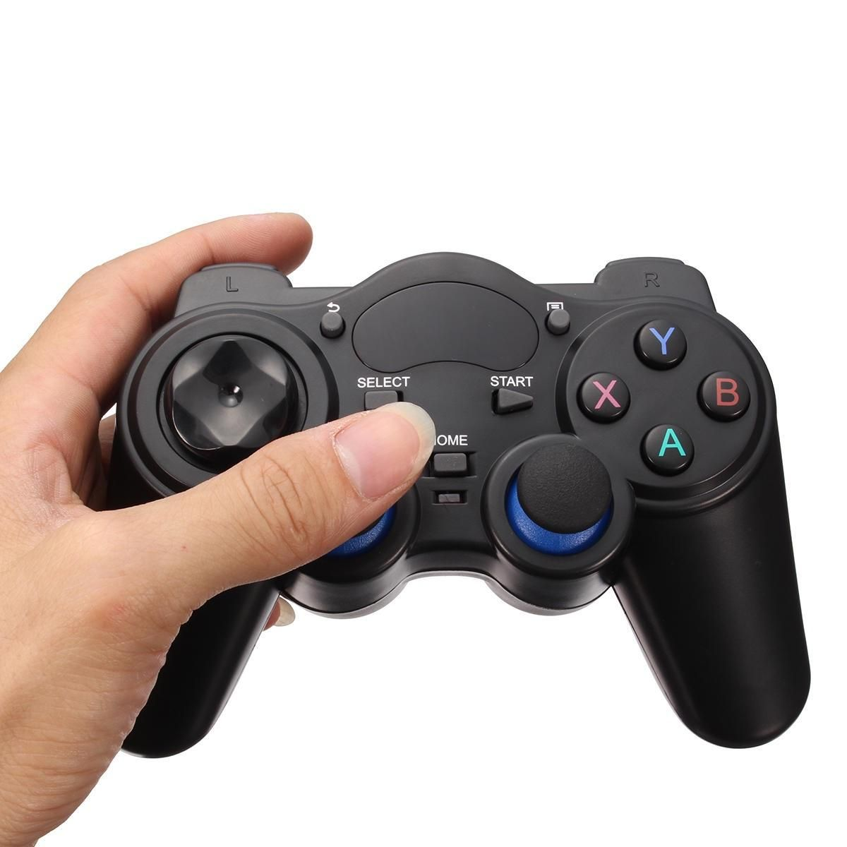
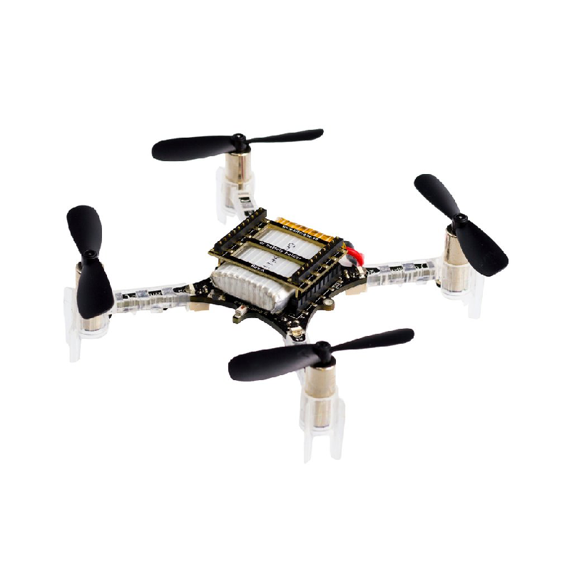
Interactions
The joystick, the drone and the client interactions are summed up in the following scheme.
The python code implements
the client interface
The sensors placed on the drone are sent to the client interface
the client configurations set the joystick commands
The joystick convert the commands of the user to
CRTP (Crazy Real Time Protocol) commands

Slide 10
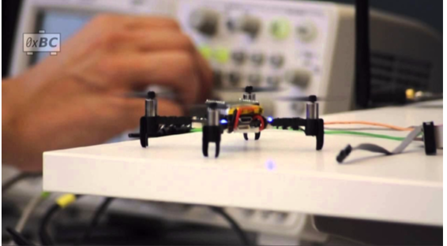
Methods
HOW ?!
So we had to find a way to impact the flight efficiency and stability of the Crazyflie 2.0. We decided to act on the CRTP protocol and generate high level commands.
Why? By writing our code section in the already existing client python code, we’re considering the Crazyflie as a “black box” that will sense deviation in some data.
When this will occur (overcoming a certain threshold), the drone will take of, stabilise, fly a trajectory and then land.

Slide 11
Test and Results
We are going to see a short video showing that we could successfully conclude our project:
The drone is held in one’s hand that will tilt smoothly until the drone’s captors sense datas overcoming the previously set thresholds (roll and pitch angles).
At this right moment, the Crazyflie 2.0 takes off, stabilises, fly a trajectory before landing back to the floor.

Slide 12
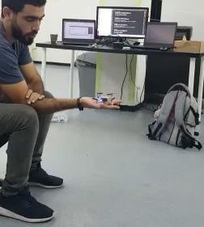

Slide 13
Wrap up
This project enabled us to get familiar to the UAV world and more specifically, to get a deep understanding of the Crazyflie 2.0 and its interactions with the software client. We could improve the stability of the device by diving into the code implementing the client and bring our modifications to it.

Slide 14
Proposal for further work
We hope that our work will be beneficial for the future engineers who wish to bring their contribution to this open source project.
Indeed, there exist quite a few new to feature to explore in order to extend further the development of the Crazyflie 2.0.

Slide 15
! THANK YOU !
! THANK YOU !
! THANK YOU !

